Slide 1
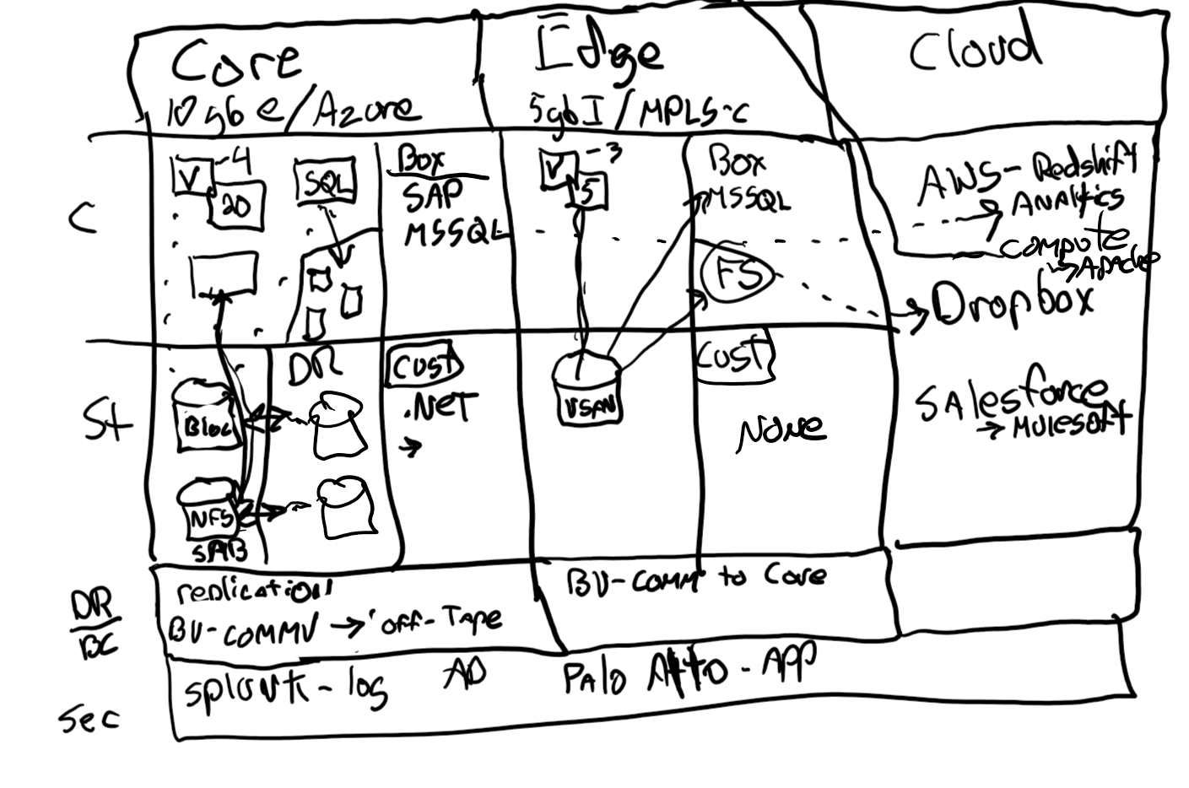
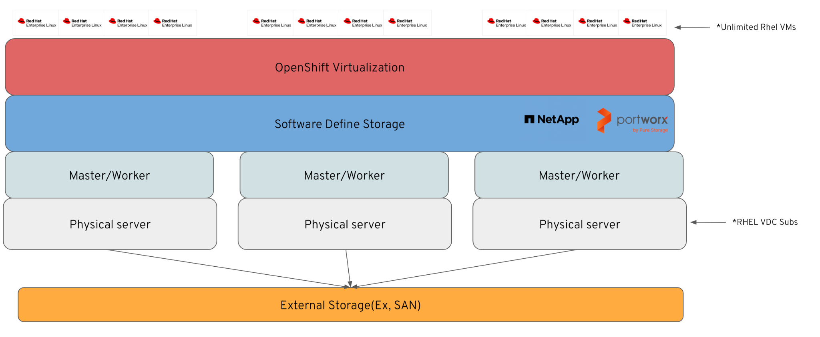
Business Goals
Virtualization
Current Architecture
Limitations
Parking Lot
Find a cost effective solution to replacing VMWARE
Simplify the management of VMs, containers, and serverless under a single pane of glass
Modernize traditional applications to accelerate innovation.
Improve the experience of developers to maximize productivity.
Due to recent changes by broadcom, vmware prices have sky rocket, hence making our vdc subs not very cost effective
Vendor lock-in, and difficult migrate to cloud
Doesn’t have native integration to GitOps, and managing multiple VMs across clusters through single dashboard
OpenShift Platform Plus is too expensive and we only have VMs. So, we want to use OVE, but we need DR capabilities, thus we want to use Red Hat’s storage solution (ODF)
Solution Levers Mapped to Business Goals
Proposed Architecture
Decisions
Next Steps /
Actions
Migrate from current hypervisor to OpenShift Virtualization
Select the workloads to be migrated to OpenShift Virtualization
Chose an Storge ISV that integrates with OCP for Disaster Recovery
Reduce infra costs by simplify the management of VMs, containers, and serverless under a single pane of glass
Increase IT agility by streamlined management across virtualization and containerized environments that reduces operational complexity
Streamline application delivery with a platform that enables self-service options and integrations with CI/CD pipelines.
Partner led discovery
Identify any potential compatibility challenges in migrating workloads
Assess customer readiness and skill gaps for managing OpenShift Virtualization
Identify cost-comparison scenarios between VMware and OpenShift Virtualization for different workloads
Timelines
Budget
Week 1-4: Assess VMware workloads, plan migration strategy, and finalize architecture.
Week 5-8: Set up POC, test VM migration, and validate DR integration.
Week 9-12: Pilot deployment with non-production workloads and team training.
Week 13-20: Full-scale migration, performance optimization, and governance setup.
Week 21+: Post-migration review, automation enhancements, and continuous improvement.

Slide 2
Agenda Tracking
Client Company Name:
Details:
Business Goals
Current Architecture
Limitation
Parking lot
Solution Levers Mapped to
Business Goals
Proposed Architecture
Decisions
Next Steps / Actions
Decisions
Timelines
Budget

Slide 3
Business Goals: Virtualization
Find a cost effective solution to replacing VMWARE
Simplify the management of VMs, containers, and serverless under a single pane of glass
Modernize traditional applications to accelerate innovation.
Improve the experience of developers to maximize productivity.

Slide 4
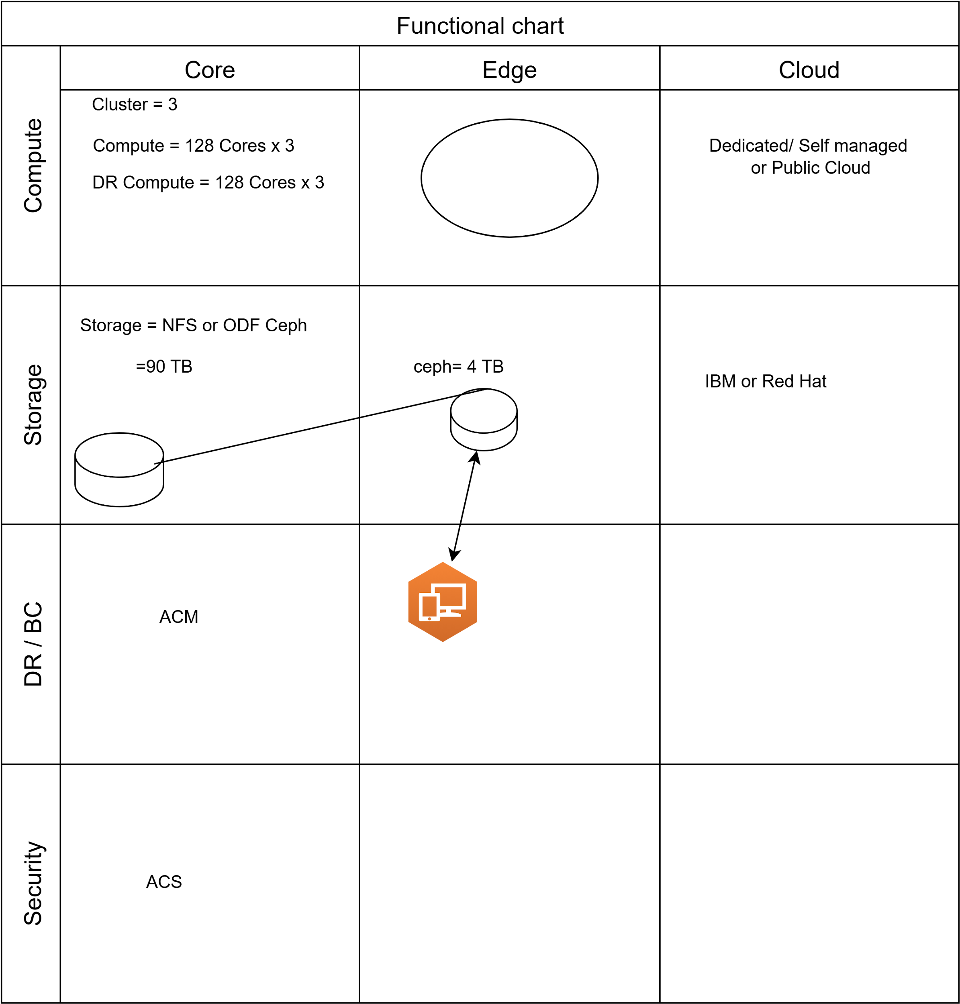
Current Architecture

Slide 5
Limitations
Due to recent changes by broadcom, vmware prices have sky rocket, hence making our vdc subs not very cost effective
Vendor lock-in, and difficult migrate to cloud
Doesn’t have native integration to GitOps, and managing multiple VMs across clusters through single dashboard

Slide 6
Parking Lot
OpenShift Platform Plus is too expensive and we only have VMs. So, we want to use OVE, but we need DR capabilities, thus we want to use Red Hat’s storage solution (ODF)

Slide 7
Solution Levers Mapped to Business Goals
Reduce infra costs by simplify the management of VMs, containers, and serverless under a single pane of glass
Increase IT agility by streamlined management across virtualization and containerized environments that reduces operational complexity
Streamline application delivery with a platform that enables self-service options and integrations with CI/CD pipelines.

Slide 8
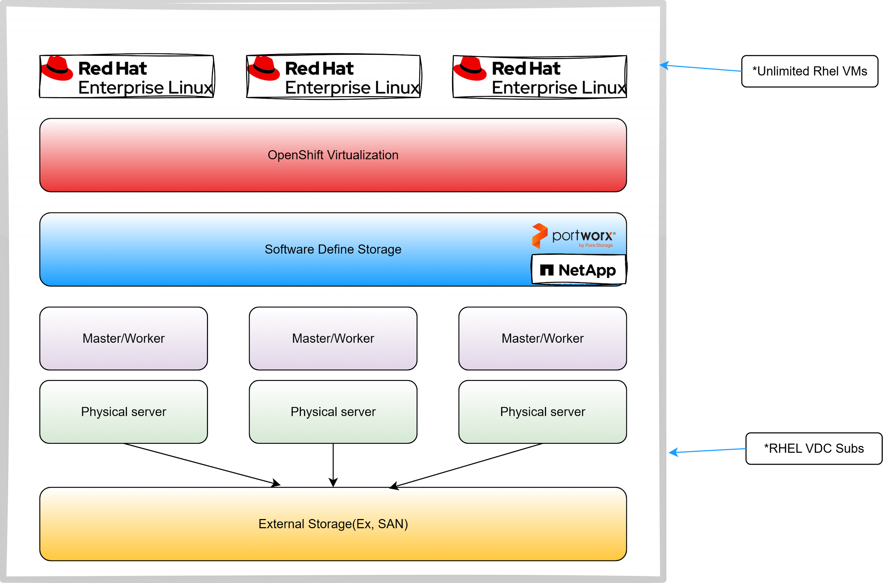
Proposed Architecture
Proposed Architecture

Slide 9
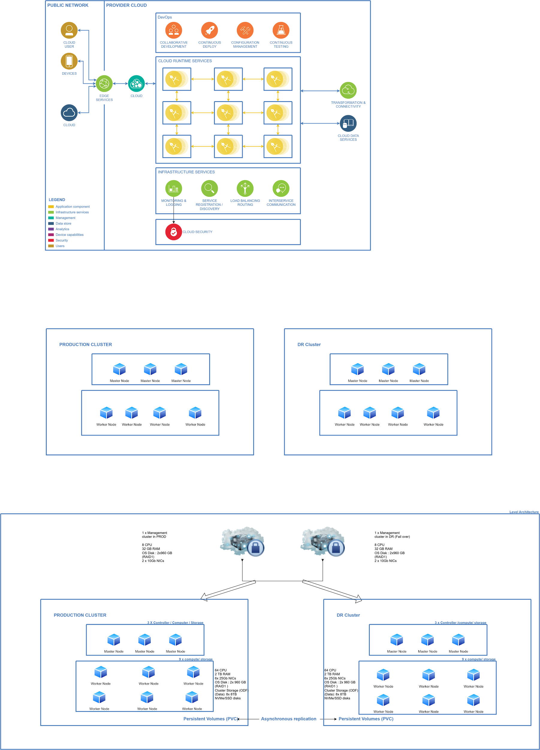
Proposed Architecture
Proposed Architecture

Slide 10
Decisions
Migrate from current hypervisor to OpenShift Virtualization
Select the workloads to be migrated to OpenShift Virtualization
Chose an Storge ISV that integrates with OCP for Disaster Recovery

Slide 11
Next Steps / Actions
Partner led discovery
Identify any potential compatibility challenges in migrating workloads
Assess customer readiness and skill gaps for managing OpenShift Virtualization
Identify cost-comparison scenarios between VMware and OpenShift Virtualization for different workloads

Slide 12
Timelines
Week 1-4: Assess VMware workloads, plan migration strategy, and finalize architecture.
Week 5-8: Set up POC, test VM migration, and validate DR integration.
Week 9-12: Pilot deployment with non-production workloads and team training.
Week 13-20: Full-scale migration, performance optimization, and governance setup.
Week 21+: Post-migration review, automation enhancements, and continuous improvement.
Week 1-4
Week 5-8
Week 9-12
Week 13-20
Week 21+
Assess VMware workloads, plan migration strategy, and finalize architecture.
Set up POC, test VM migration, and validate DR integration.
Pilot deployment with non-production workloads and team training.
Full-scale migration, performance optimization, and governance setup.
Post-migration review, automation enhancements, and continuous improvement.

Slide 13
Budget
250,000 Eu

